Slide 1



Automatic Hand Gel Dispenser
Supervisor & Professor
Dr. Majdi Richa
Prepared by:
Mary-Lynn El hayek
maria Kfoury

Slide 2
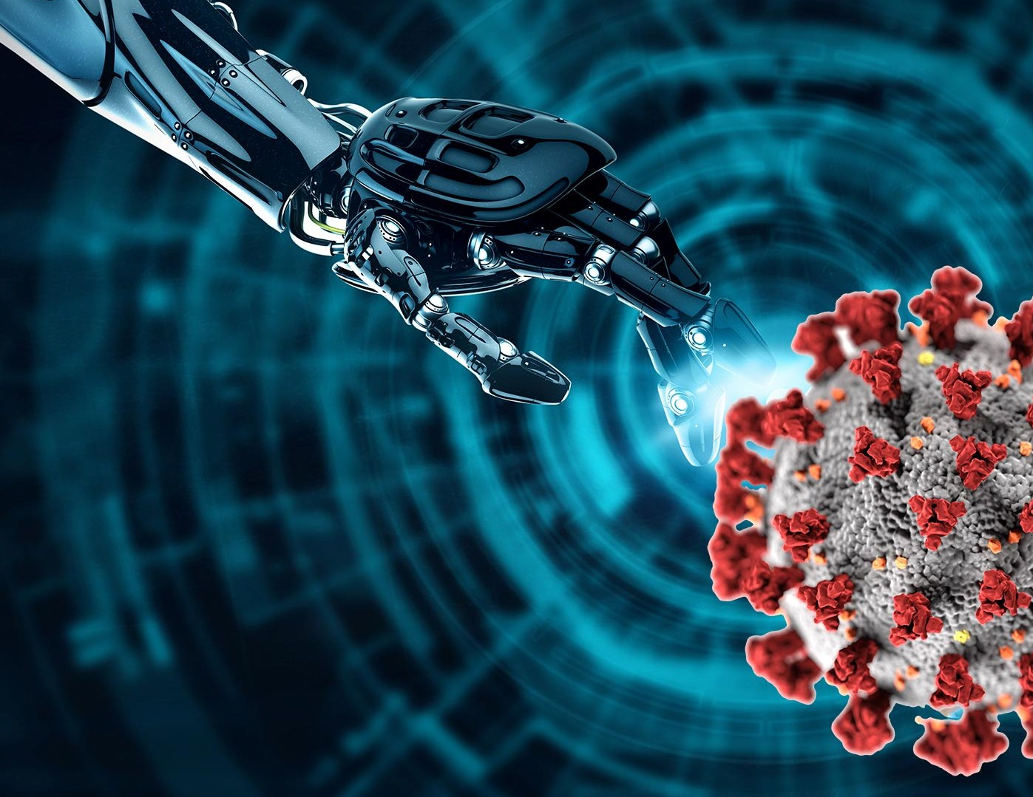
OUTLINE
Introduction
Subject & Goal
Block Diagram
Hardware presentation
Software Presentation
Results
Problems Encountered
Future Expansions

Slide 3


Technical Environment
Integrated Development Environment
Proteus 8 Professional

Slide 4
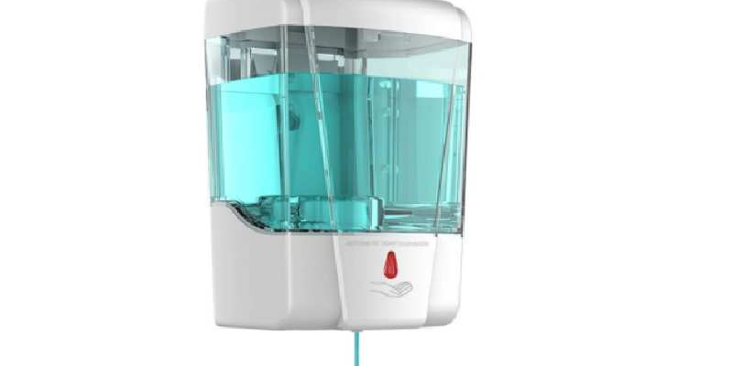

Subject And Goal

Slide 5
Block Diagram Simulation

Slide 6
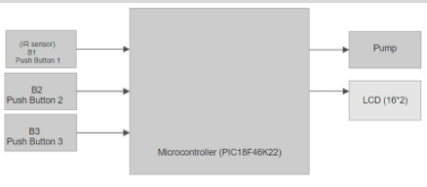
Block Diagram

Slide 7
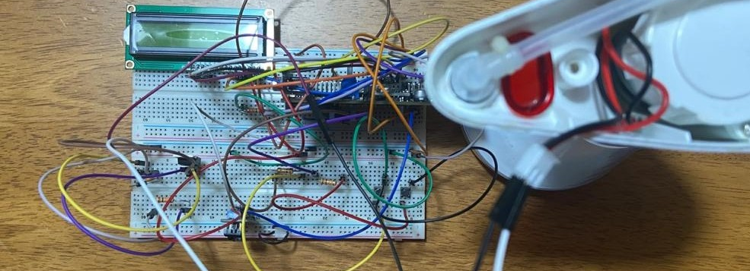
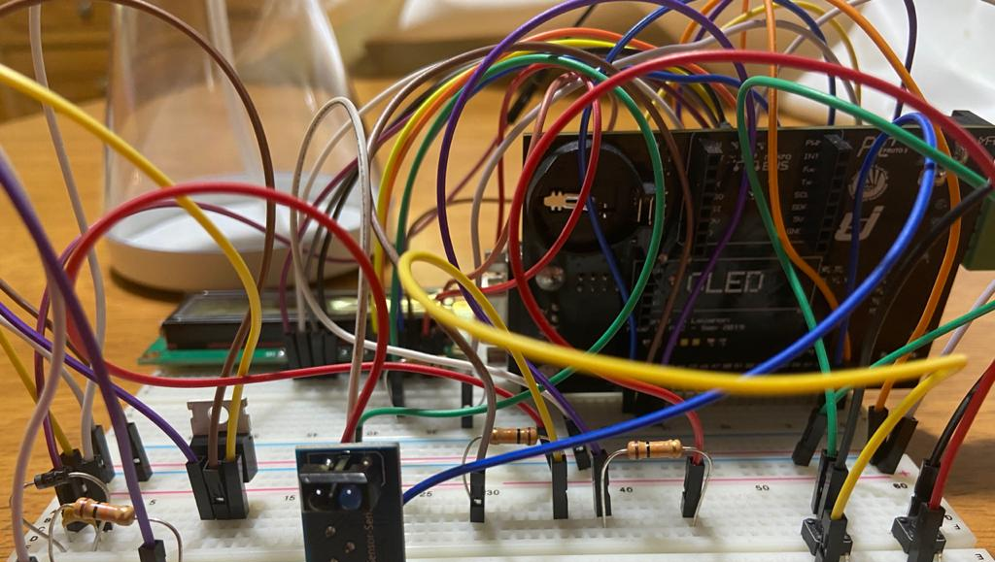
HARDWARE PRESENTATION

Slide 8
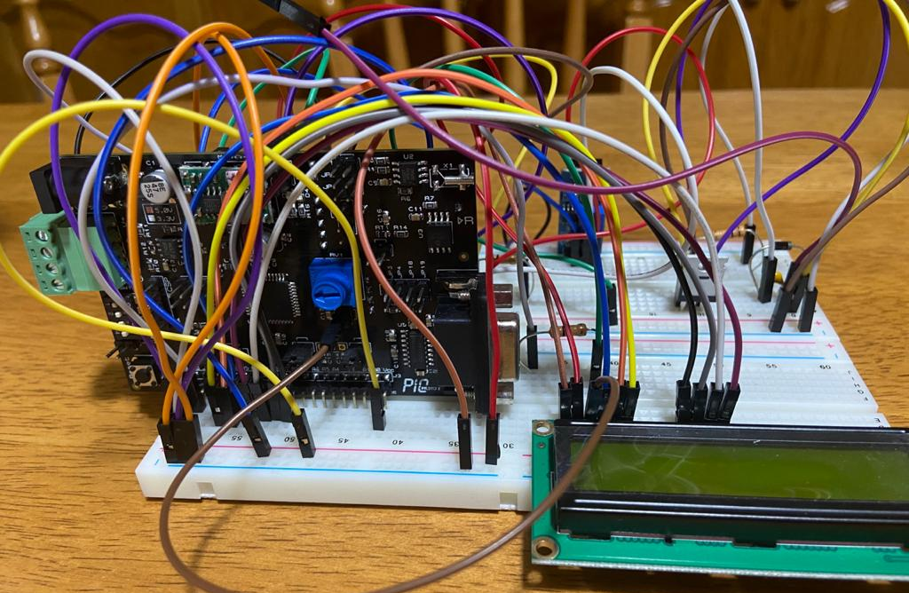
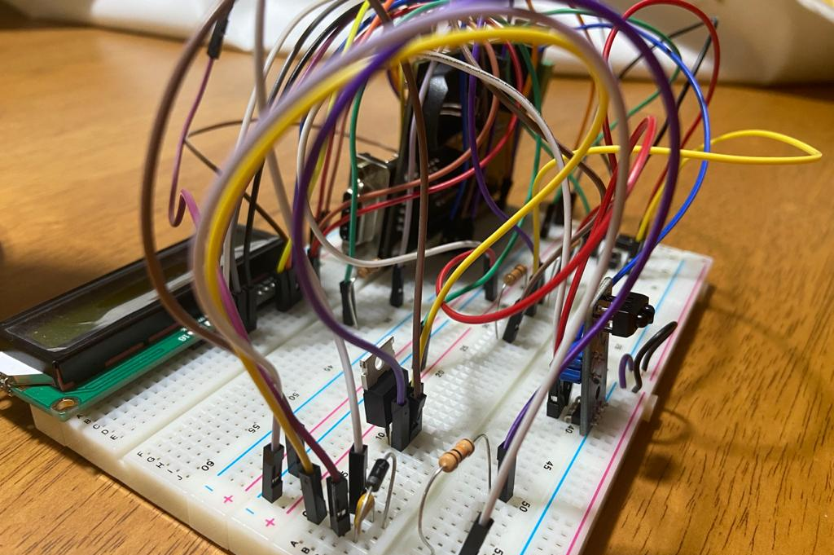
Left and front view of the hardware without the pump connected

Slide 9
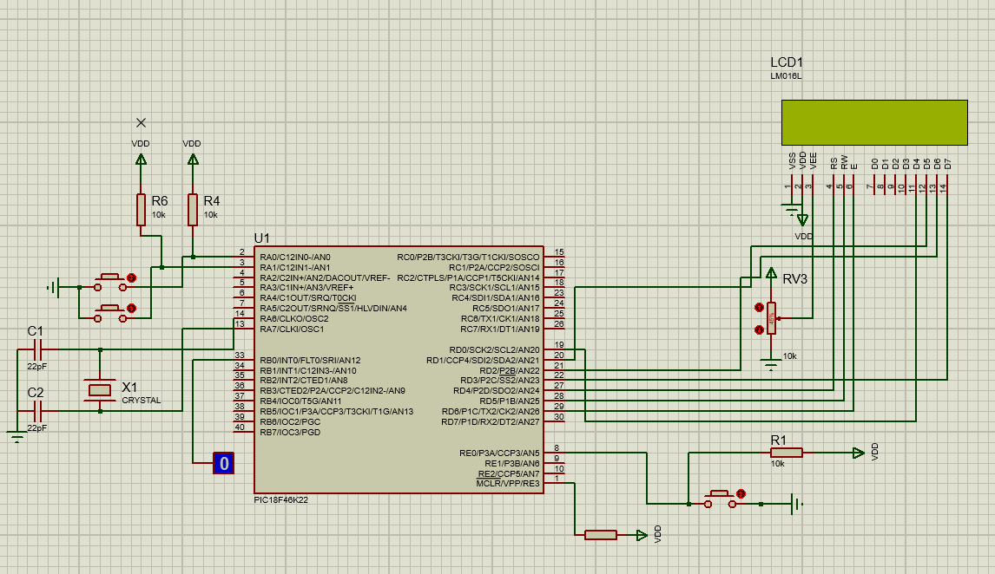
Software Presentation

Slide 10
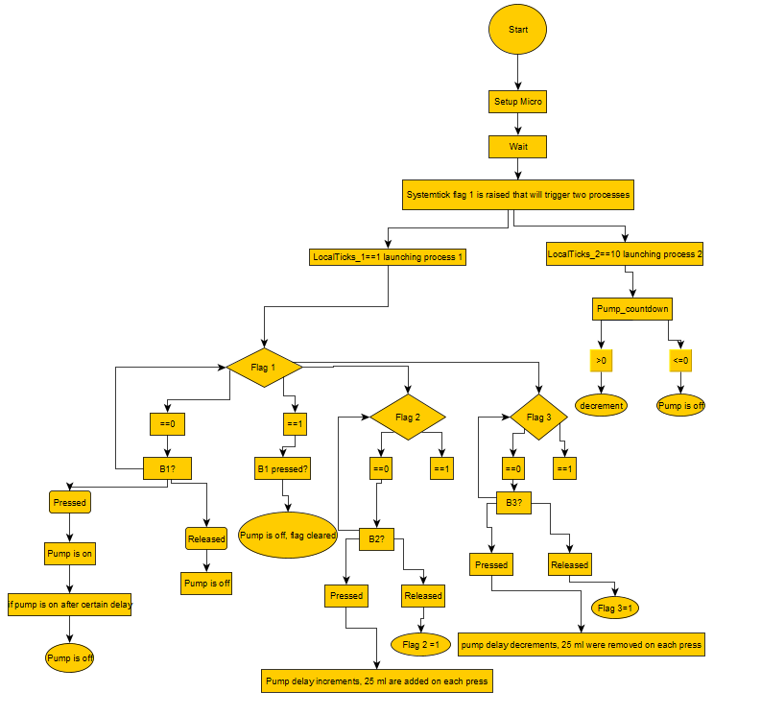
Software Flowchart

Slide 11
Results
Unfortunately, the implementation of the code on the hardware did not work when it was working just fine before but the simulation is working perfectly.

Slide 12

Problems Encountered
Pump to stop dispensing even if hand is still placed
Pandemic
Implementation of the code

Slide 13
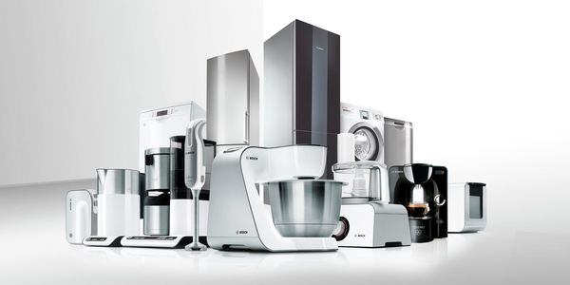
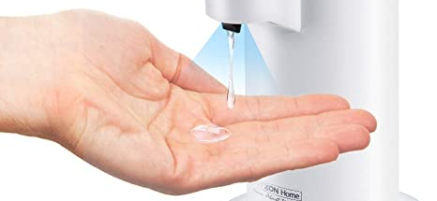
Future Expansions
Using this system on all appliances minimizing human touch
Adding two more sensors
Voice controlled hand gel dispenser
Changing the type of product poured into the pump

Slide 14


